Slide 1
Unit 4 - Task 1
By Joseph Roper, Cameron Whittle and James Diep

Slide 2
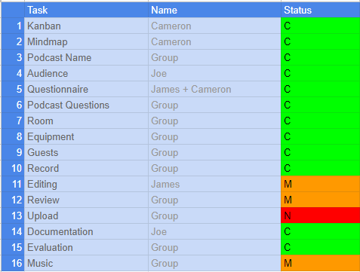
Kanban
Our group found the kanban very useful as it gave us a checklist to complete and made sure we didn't forget to do anything as we went along with our project. It also allowed us to know who was doing what so that we didn't have two people doing the same thing or someone doing nothing.

Slide 3
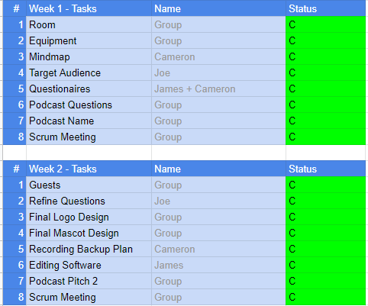
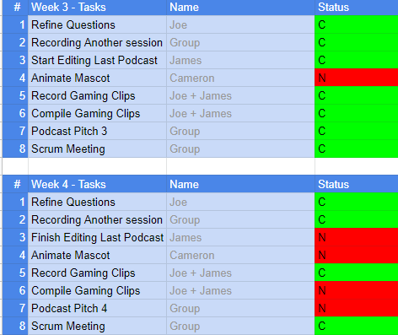
Calendar
Similar to the kanban our calendar also helped us keep more organised as it gave us goals to strive for each week so that even if we were unable to do something we weren't falling behind with mountains of work piling up on us, we could just make sure we did everything else for that week and if we had time we would do some of the next weeks work.

Slide 4
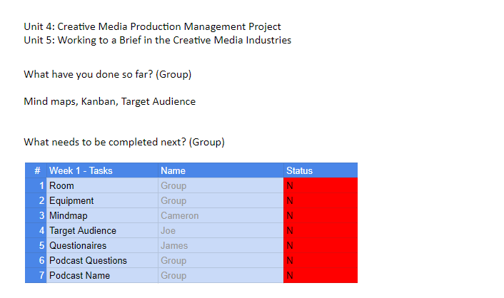
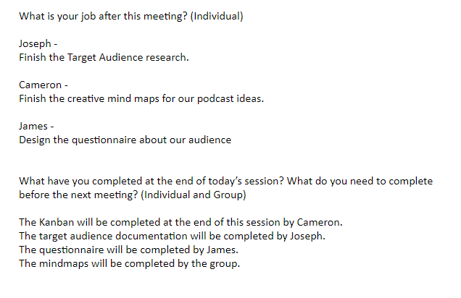
Scrum Logs
With the help of our scrum logs we were able to keep track of where others were individually without having to ask each other constantly, removing any worries of others being behind.
Scrum Log 1 Scrum Log 2 Scrum Log 3

Slide 5
Target Audience
15+ - There might be minor swearing in the podcast.
I believe the podcast should be 15+ as we will be talking like we do in a normal conversation and some swearing might occur and the topics we will be talking about will relate to that audience as it is what our group is interested in.
Demographic:
The demographics of our audience will most likely enjoy games as we will be talking about games and game related issues. We will also discuss about current shows and jokes on the internet.
Psychographics:
The lifestyles of our audience will most likely be people who spend their time inside playing games or enjoying media. People who like the Everyday Beam Struggle podcast and the Cold Ones podcast and various other gaming talk shows will enjoy ours.

Slide 6
Resources Available
Our college will provide us with a room to record our podcast in. Our tutor will help us with this as he has experience with students planning and creating podcasts therefore he will be able to look at our Kanban and tell us if the work will be achievable with our short time scale. We will also search for tutorials online on how to edit our podcast and get a free editing software on the internet also.
Reflecting back on prior units we are now better at communicating with each other and planning projects due to working with each other for a year and working together and separately creating new projects each time. We are also now good at filing work so it is easy to find and are good at sticking to deadlines.

Slide 7
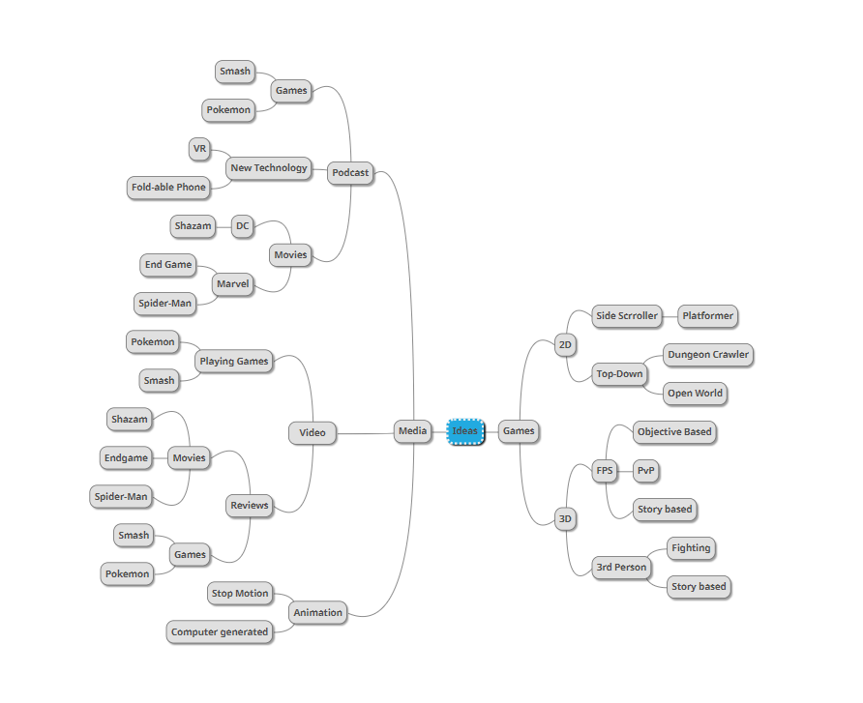
Mindmap
For our final idea we chose a Podcast as we believed that this was something our team was most capable of doing whilst also challenging ourselves to do new things such as speaking to a wide audience.
We also believed that a podcast allowed us the most freedom as you can pick a bunch of different topics and talk about them, rather than choosing one topic and having to stick with it till the end.

Slide 8
Target Audience Questionnaire
We made a survey that we had the public fill out to determine what our target audience will be for our podcast as well as some other information we needed until we started producing the podcast. What we found was that our podcast should be made for 14 - 21 year olds who like games. We also now know that we should make our podcast be edited down to 10 - 30 minutes.
https://forms.gle/XuQ6P2pwz1sRuVAd9

Slide 9
Product Management
The agile management method involves creating a prototype of your idea each week. Advantages of this are you have a guaranteed product at the end of each week. A disadvantage of this method is that the outcome can be unpredictable.
The scrum management method involves producing logs each week of what work has been done and what needs to be done next. An advantage of this is that you know your next job is. A disadvantage is that it can be derailed is someone in the project doesn’t complete their work.
Sprint stands for 1 week of work for example the scrum logs we produced each week indicating the work we had done would be a sprint and the work that had to be done would be apart of next week's sprint.
The Waterfall method is when you make your project step by step for example if it were a car you would make the body of the car, then the doors, then the windows ect. Advantages of this are it has a clearly defined work structure for what need to be done. A disadvantage of this is that it is susceptible to delays as if you don’t complete the current work you can't go onto the next stage.
A kanban visualizes the team's workflow onto a document for example with ours we had a list on google sheets indicating in red what had not been completed. An advantage of this is that it is easy to read the document for what needs to be done.

Slide 10
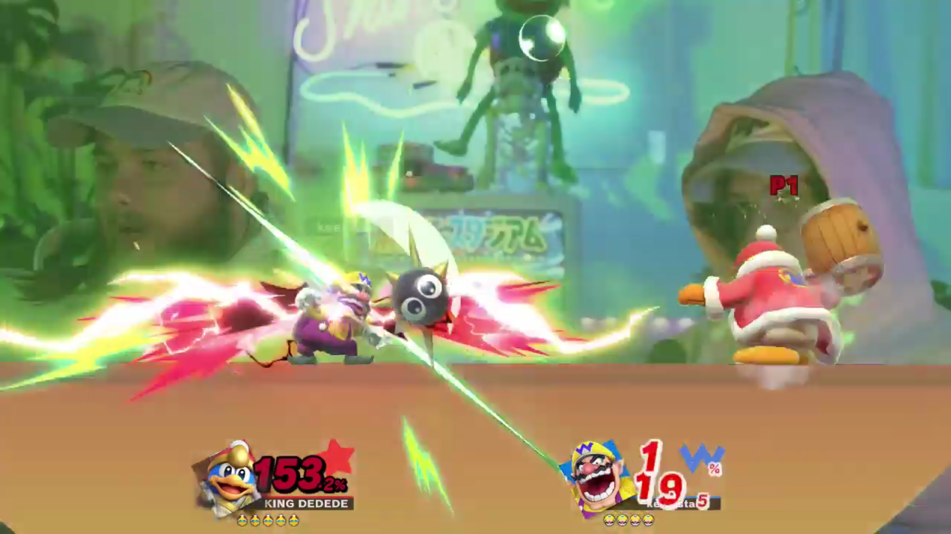
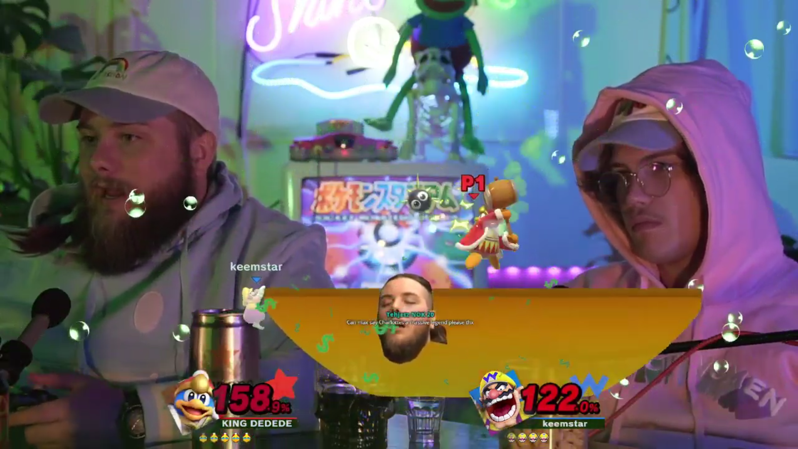
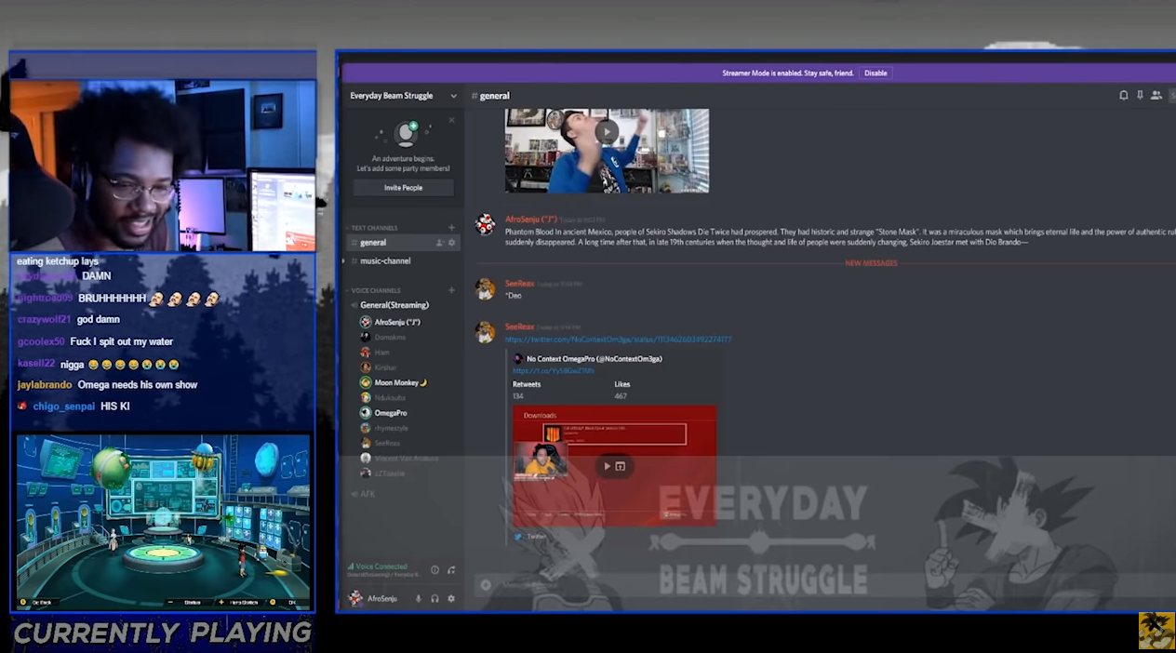
Final Idea Summary
Our chosen idea is to create a Podcast for people our age with the same interests as us which are games such as Pokemon and Smash Bros and media such as anime and movies.
This is based on having an interest in gaming and anime related podcasts ourselves. Such as Cold ones, AfroSenju’s Everyday Beam Struggle podcast.

Slide 11
Appropriate Content
Our target audience enjoy games and the entertainment media, we talk about the controversies and news surrounding them as well as discussions and debates on a topic.
Therefore they will enjoy my product because we talk about the new starter pokemon in the pokemon game for 2019. We also talk about how VR and AR may work in the future and our thoughts on it as well as discussing anything related to it like the Matrix.

Slide 12
My management Technique
We have chosen to use the agile method. This will involve creating prototypes of our project each week. We chose this because it guarantees we’ll have a product each week and it keeps us working as a group.

Slide 13
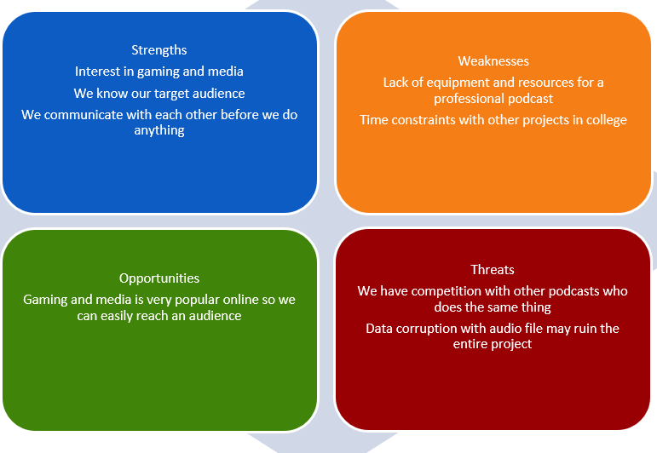
Constraints
Here is our SWOT analysis:
We need to be careful of our competition more specifically the Uncultured Podcast team who may prove to be a threat since they will be talking about similar topics as us. In order to get by these constraints we will simply have to be better than them and make a more entertaining podcast.

Slide 14
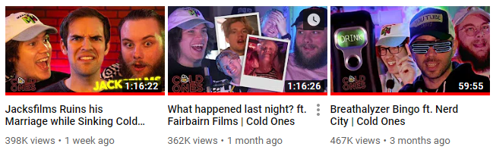
Competition
My product will be competing with another podcast set up by a group of students in my class. Although I believe this will not be an issue as we both enjoy entirely different games and media therefore the two podcasts will be for different audiences.
As you can see from the screenshot from the Cold Ones podcast channel each podcast gains up to 400K views getting up to a million overtime meaning there is a massive audience for our own podcast.

